Slide 1
FreeACS Development Guide
Paul
29.Jun.2018
Quber

Slide 2
Agenda
Base Technologies
Component
How to Build
DB Configuration & Schema
Component Detail

Slide 3
Overview

Slide 4
General Information
HomePage
https://github.com/freeacs/freeacs
Wiki : https://github.com/freeacs/freeacs/wiki
Documents : https://github.com/freeacs/readme
Repository
https://github.com/freeacs/freeacs.git

Slide 5
Base Technologies
FreeMaker
F/E
SpringBoot
(Java)
MySQL
B/E
DB
Build tool
SBT
(Scala Build Tool)

Slide 6
Want to be...
Vue.js
F/E
Thymeleaf
BootStrap
SpringBoot
(Java)
MySQL
MongoDB
B/E
Build tool
SBT

Slide 7
Components
Fusion Product Description.pdf

Slide 8
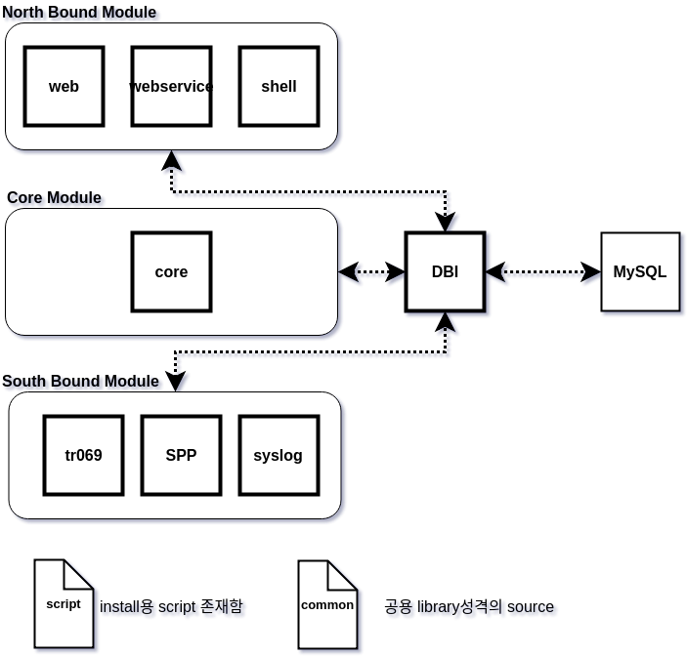
FreeACS Components

Slide 9
Brief Description for FreeACS Components
Component | Role
Web | CPE를 관리하기 위한 Admin이 접속하는 Web Server 처리
WebService | 3rd party와 연동하기 위한 interface 담당
Shell | CPE를 관리하기 위한 Admin이 접속하는 shell 처리
Core | Background job이나 syslog/report를 처리
TR069 | CPE와 직접 연동하는 message처리
Syslog | Syslog server
DBI | DB와 interface담당

Slide 10
Component [Core]
Refer.
core/docs/Fusion Core User Manaual.pdf
Role
background에서 수행되는 일들을 담당
Mission
Job Management
Syslog Deletion
Report Generation
Configuration
core/src/main/resources/application.properties

Slide 11
Questions
How to communicate between components?
Via DB
So, DBI module has to do something like that triggering detection etc.

Slide 12
Role & Relationship
Role
Core
Tr069
Web
Webservice
Stun
Syslog
Relationship
Core vs. Tr069
Web vs. Webservice
Stun vs. Tr069/Core

Slide 13
How to build

Slide 14
Build Environment
Build tool
2018.6.29 현재, SBT(Simple Build Tool)임
2018.6월경부터 freeacs의 build tool이 maven --> sbt로 변경됐다
SBT관련 file
File | Description
build.sbt | Main build script
version.sbt | Build version (sbt version 명령어 입력시 각 component의 build 버전정보에 표시됨)
/project/build.properties | SBT의 version
/project/Dependencies.scala | build.sbt에서 사용하는 각종 외부 library들에 대한 정의
/project/plugins.sbt | 추가할 SBT plugin 정보

Slide 15
Build Command
In project's root directory,
Command : sbt clean compile stage
stage : packaging 및 배포 바이너리를 생성함
배포용 binary 위치
Component | Path | Port | Context Path
TR-069 | tr069/target/universal/stage/bin/freeacs-tr069 | 8085 | /tr069
Core | core/target/universal/stage/bin/freeacs-core | 8083 | /core
STUN | stun/target/universal/stage/bin/freeacs-stun | 8087 | /stun
WEB | web/target/universal/stage/bin/freeacs-web | 8081 | /web
WebService | webservice/target/universal/stage/bin/freeacs-webservice | 8088 | /webservice
SysLog | syslog/target/universal/stage/bin/freeacs-syslog | 8086 | /syslog
Shell | shell/target/universal/stage/bin/freeacs-shell | - | -

Slide 16
Configuration
Context-path 및 port 변경
각 component의 application.properties에서 변경
server.servlet.context-path : component의 context-path명
server.port : service port

Slide 17
How to build WAR file instead of jar file

Slide 18
DB

Slide 19
How to create original DB tables?
Procedure
Download install.sql
Run install.sql to create DB schema
Path 'install.sql' file
https://github.com/freeacs/mysql
Repository : https://github.com/freeacs/mysql.git
You can find 'install.sql'
How to create DB schema
> mysql –u$ID –p$PW $DB_name < install.sql
Ex> mysql –uacs –pacs acs < install.sql

Slide 20
DB Schema
Google Drive
01.QDMS > 01.Analysis > 04.FreeACS > 01.Documents > MySQL_ERD > freeacs_schema.mwb 참조

Slide 21
How to handle DB in DBI module

Slide 22
If MongoDB is used...

Slide 23
References

